Slide 1
William Stallings
Data and Computer Communications
7th Edition
Chapter 6
Digital Data Communications Techniques

Slide 2
Asynchronous and Synchronous Transmission
Timing problems require a mechanism to synchronize the transmitter and receiver
Two solutions
  Asynchronous
  Synchronous

Slide 3
Asynchronous
Data transmitted on character at a time
  5 to 8 bits
Timing only needs maintaining within each character
Resynchronize with each character

Slide 4
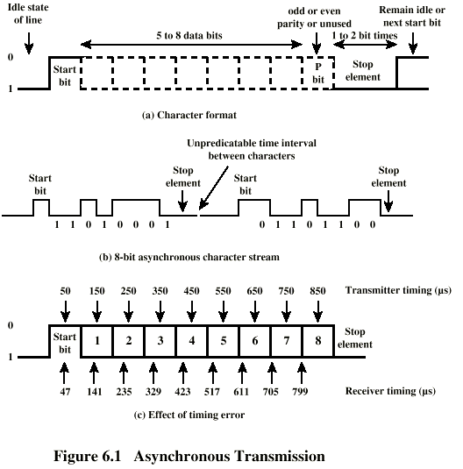
Asynchronous (diagram)

Slide 5
Asynchronous - Behavior
In a steady stream, interval between characters is uniform (length of stop element)
In idle state, receiver looks for transition 1 to 0
Then samples next seven intervals (char length)
Then looks for next 1 to 0 for next char
Simple
Cheap
Overhead of 2 or 3 bits per char (~20%)
Good for data with large gaps (keyboard)

Slide 6
Synchronous - Bit Level
Block of data transmitted without start or stop bits
Clocks must be synchronized
Can use separate clock line
  Good over short distances
  Subject to impairments
Embed clock signal in data
  Manchester encoding
  Carrier frequency (analog)

Slide 7
Synchronous - Block Level
Need to indicate start and end of block
Use preamble and postamble
  e.g. series of SYN (hex 16) characters
  e.g. block of 11111111 patterns ending in 11111110
More efficient (lower overhead) than async

Slide 8
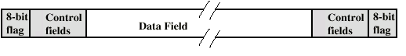
Synchronous (diagram)

Slide 9
Types of Error
An error occurs when a bit is altered between transmission and reception
Single bit errors
  One bit altered
  Adjacent bits not affected
  White noise
Burst errors
  Length B
  Contiguous sequence of B bits in which first last and any number of intermediate bits in error
  Impulse noise
  Fading in wireless
  Effect greater at higher data rates

Slide 10
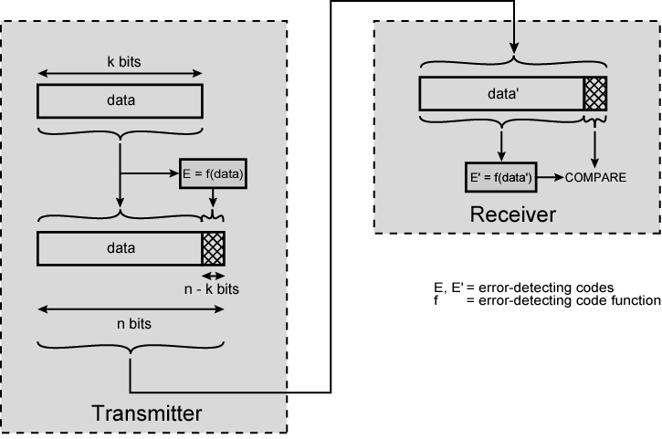
Error Detection Process

Slide 11
Error Detection
Additional bits added by transmitter for error detection code
Parity
  Value of parity bit is such that character has even (even parity) or odd (odd parity) number of ones
  Even number of bit errors goes undetected

Slide 12
Cyclic Redundancy Check
For a block of k bits transmitter generates n bit sequence
Transmit k+n bits which is exactly divisible by some number
Receive divides frame by that number
  If no remainder, assume no error
  For math, see Stallings chapter 6

Slide 13
Error Correction
Correction of detected errors usually requires data block to be retransmitted (see chapter 7)
Not appropriate for wireless applications
  Bit error rate is high
    Lots of retransmissions
  Propagation delay can be long (satellite) compared with frame transmission time
    Would result in retransmission of frame in error plus many subsequent frames
Need to correct errors on basis of bits received

Slide 14
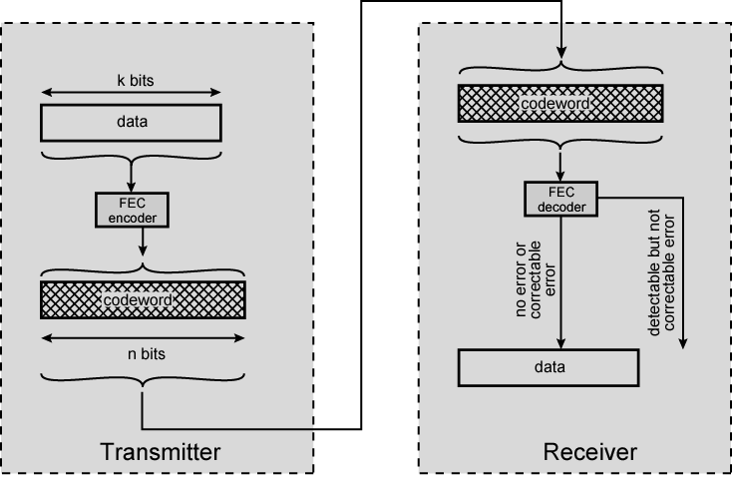
Error Correction Process Diagram

Slide 15
Error Correction Process
Each k bit block mapped to an n bit block (n>k)
  Codeword
  Forward error correction (FEC) encoder
Codeword sent
Received bit string similar to transmitted but may contain errors
Received code word passed to FEC decoder
  If no errors, original data block output
  Some error patterns can be detected and corrected
  Some error patterns can be detected but not corrected
  Some (rare) error patterns are not detected
    Results in incorrect data output from FEC

Slide 16
Working of Error Correction
Add redundancy to transmitted message
Can deduce original in face of certain level of error rate
E.g. block error correction code
  In general, add (n – k ) bits to end of block
    Gives n bit block (codeword)
    All of original k bits included in codeword
  Some FEC map k bit input onto n bit codeword such that original k bits do not appear
Again, for math, see chapter 6

Slide 17
Line Configuration
Topology
  Physical arrangement of stations on medium
  Point to point
  Multi point
    Computer and terminals, local area network
Half duplex
  Only one station may transmit at a time
  Requires one data path
Full duplex
  Simultaneous transmission and reception between two stations
  Requires two data paths (or echo canceling)

Slide 18
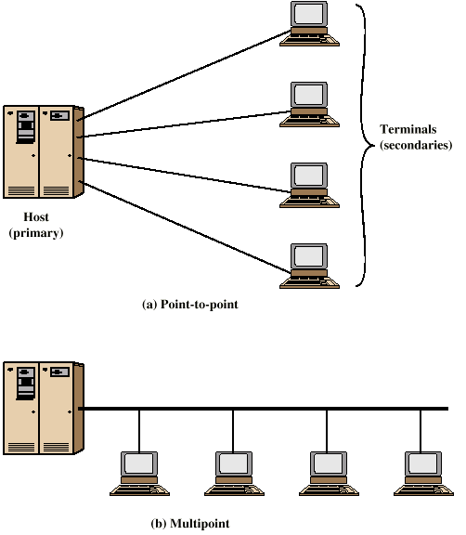
Traditional Configurations

Slide 19
Interfacing
Data processing devices (or data terminal equipment, DTE) do not (usually) include data transmission facilities
Need an interface called data circuit terminating equipment (DCE)
  e.g. modem, NIC
DCE transmits bits on medium
DCE communicates data and control info with DTE
  Done over interchange circuits
  Clear interface standards required

Slide 20
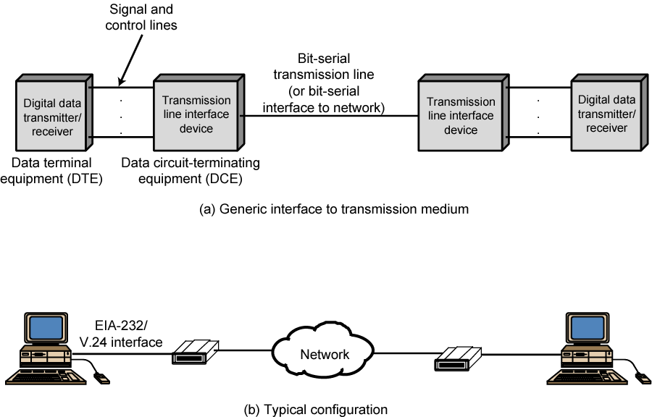
Data Communications Interfacing

Slide 21
Characteristics of Interface
Mechanical
  Connection plugs
Electrical
  Voltage, timing, encoding
Functional
  Data, control, timing, grounding
Procedural
  Sequence of events

Slide 22
V.24/EIA-232-F
ITU-T v.24
Only specifies functional and procedural
  References other standards for electrical and mechanical
EIA-232-F (USA)
  RS-232
  Mechanical ISO 2110
  Electrical v.28
  Functional v.24
  Procedural v.24

Slide 23
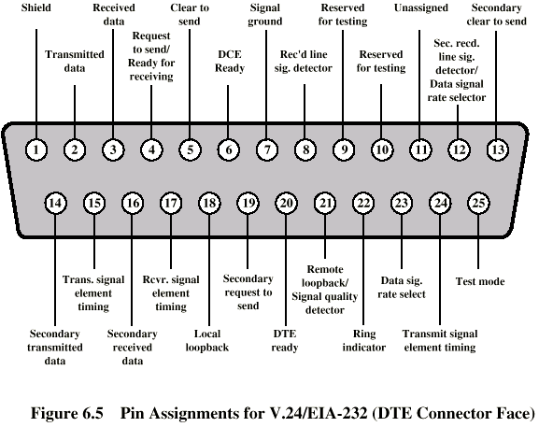
Mechanical Specification

Slide 24
Electrical Specification
Digital signals
Values interpreted as data or control, depending on circuit
More than -3v is binary 1, more than +3v is binary 0 (NRZ-L)
Signal rate < 20kbps
Distance <15m
For control, more than-3v is off, +3v is on

Slide 25
Functional Specification
Circuits grouped in categories
  Data
  Control
  Timing
  Ground
One circuit in each direction
  Full duplex
Two secondary data circuits
  Allow halt or flow control in half duplex operation
(See table in Stallings chapter 6)

Slide 26
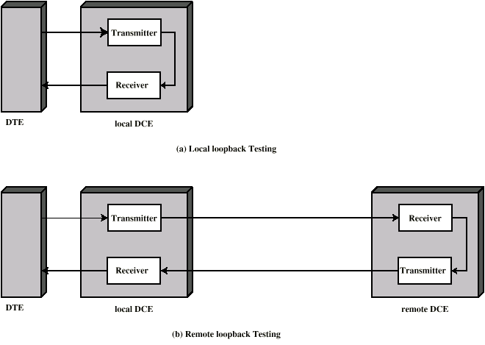
Local and Remote Loopback

Slide 27
Procedural Specification
E.g. Asynchronous private line modem
When turned on and ready, modem (DCE) asserts DCE ready
When DTE ready to send data, it asserts Request to Send
  Also inhibits receive mode in half duplex
Modem responds when ready by asserting Clear to send
DTE sends data
When data arrives, local modem asserts Receive Line Signal Detector and delivers data

Slide 28
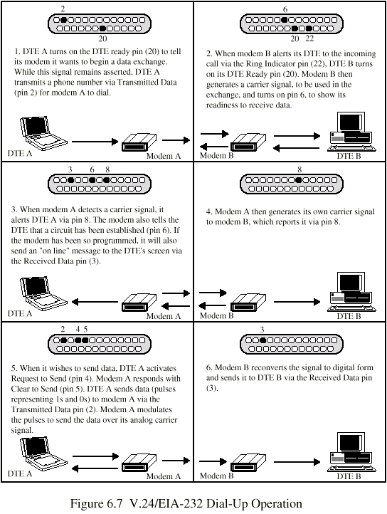
Dial Up Operation (1)

Slide 29
Dial Up Operation (2)

Slide 30
Dial Up Operation (3)

Slide 31
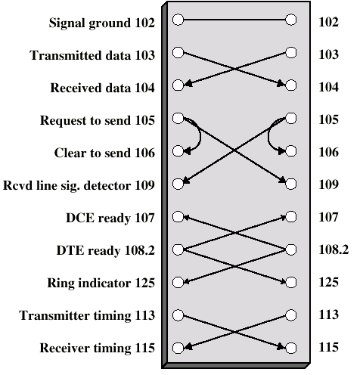
Null Modem

Slide 32
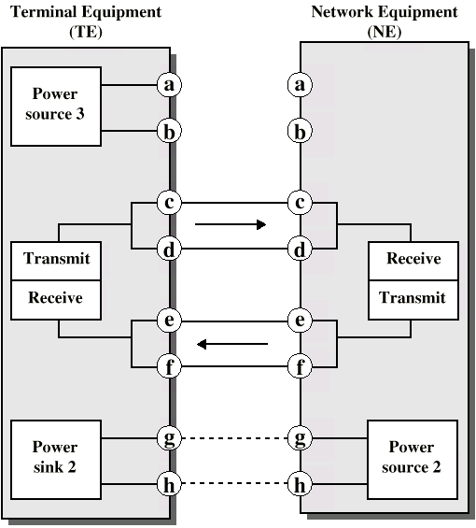
ISDN Physical Interface Diagram

Slide 33
ISDN Physical Interface
Connection between terminal equipment (c.f. DTE) and network terminating equipment (c.f. DCE)
ISO 8877
Cables terminate in matching connectors with 8 contacts
Transmit/receive carry both data and control

Slide 34
ISDN Electrical Specification
Balanced transmission
  Carried on two lines, e.g. twisted pair
  Signals as currents down one conductor and up the other
  Differential signaling
  Value depends on direction of voltage
  Tolerates more noise and generates less
  (Unbalanced, e.g. RS-232 uses single signal line and ground)
  Data encoding depends on data rate
  Basic rate 192kbps uses pseudoternary
  Primary rate uses alternative mark inversion (AMI) and B8ZS or HDB3

Slide 35
Foreground Reading
Stallings chapter 6
Web pages from ITU-T on v. specification
Web pages on ISDN

